Slide 1

MINI PROJECT 2020-21 (15ECSW301) Meme Classification
Team : E5.
Guide : Dr P.G. Sunita Hiremath.
TEAM Members:
* Varun Bohara. 01fe18bcs278
* Sakshi Tahlani. 01fe18bcs271
* Abhishek Rao. 01fe18bcs297
* Madhurika Ganiger. 01fe18bcs284

Slide 2
Outline
INTRODUCTION
MOTIVATION
PROBLEM STATEMENT
OBJECTIVES
LITERATURE SURVEY
PROPOSED METHODOLOGY
REQUIREMENT ANALYSIS
REFERENCES

Slide 3
Introduction
“Memes” are cultural inside jokes, a way of connecting with people across internet through instantly recognizable photos. They collect emotions, ideas and actions into an easy-to-translate format.
Rise of memes : Besides reflecting humor ,the rise of memes has shown to be having a harmful effect on an individual as well as political, religional , communal sectors of society.
Data: Meme as an image along with embedded text .
Features: Image and text features , in the form of embedding vectors .
Multimodal Models: Interpretation of memes using multimodal models .

Slide 4

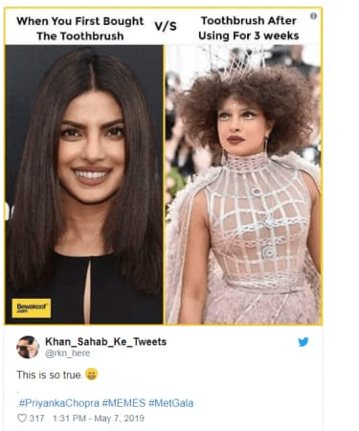

Motivation
To prevent the spread of incorrect ideology.
To tackle trolling, individual attacks and other such social criticism.
To tackle the spreading of fake news.

Slide 5
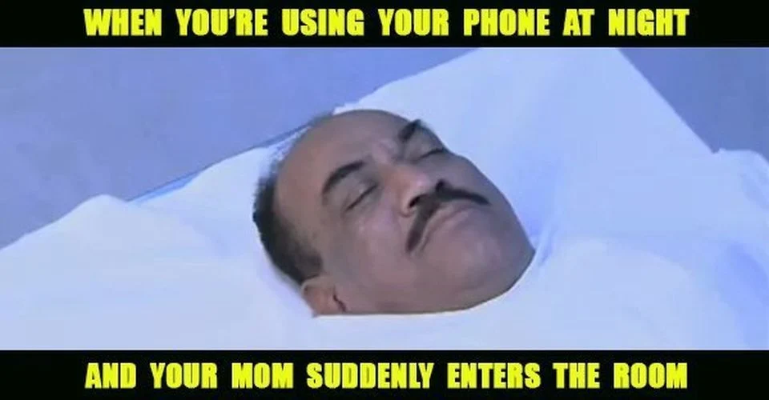

Problem Statement
To label a meme as hateful or non-hateful by developing a multimodal model.
Input
Output
Non Hateful(0)
Hateful(1)

Slide 6
Objectives
To generate embeddings of image and text .
To fuse the text and image embeddings and build a classifier.
To evaluate the performace of the multimodal model using AUC ROC.

Slide 7
Literature Survey

Slide 8
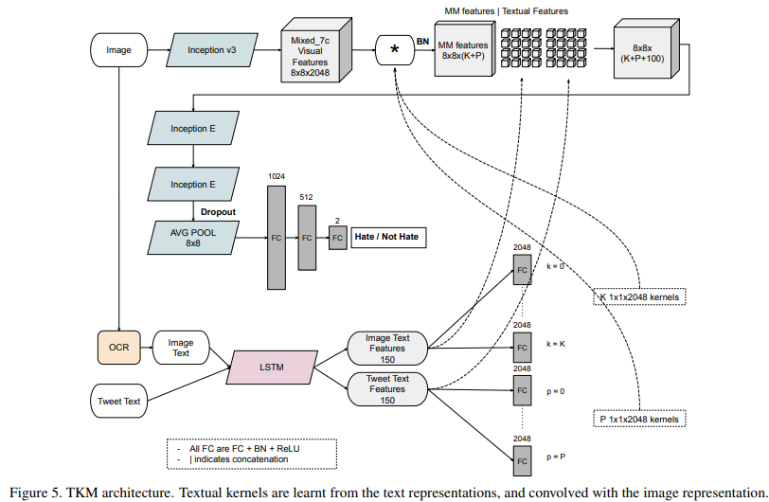
Exploring Hate Speech Detection in Multimodal Publications ( WACV, 2020) [1]
TKM( Textual Kernels Model ):
Inception Model
LSTM Model
Kernel

Slide 9
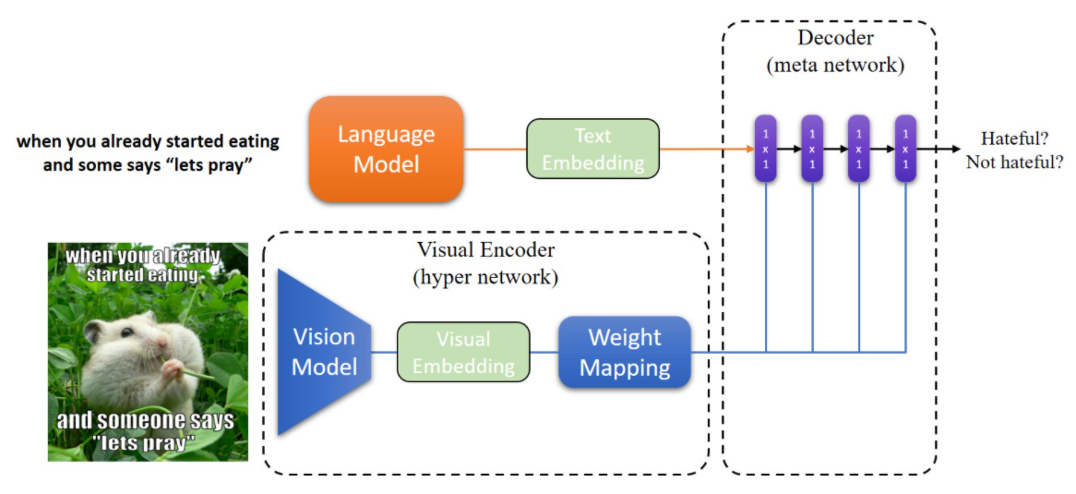
Hateful Memes Challenge 2020, SEP 22 Yuval Nirkin Assaf Rabinowitz Yoni Solel [2]
Data Processing
Text embedding :SBERT
Image Embedding: MobileNetV2
Hypernetworks
Decoder
Varun Bohara

Slide 10
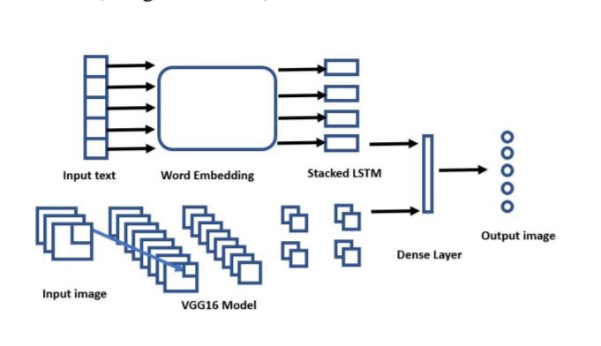
Multimodal Meme Dataset (MultiOFF) for Identifying Offensive Content in Image and Text [3] Shardul Suryawanshi, Bharathi Raja Chakravarthi, Mihael Arcan, Paul Buitelaar
Text Embedding : LSTM
Image Embedding : VGG16
Early Fusion Method

Slide 11
Proposed Methodology
Input
look! a blow up doll
Text Module (Sbert)
Decoder
Performance Evaluation
Visual Module (Inception v3)
Output
Hateful (1)/Non-Hateful (0)

Slide 12
Requirement Analysis
Functional
The model shall be able to generate image and text representations .
The model shall be able to classify the meme as hateful or non hateful using provided embeddings .
The model shall be able to generate the probability of the meme being hateful .
Non Functional
The model should be atleast 70% accurate .
The model should not under-perform on limited computing resources.

Slide 13
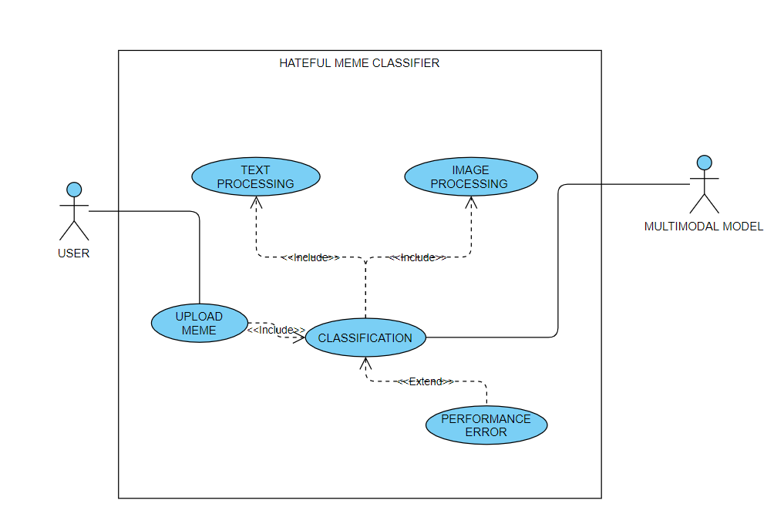
Use Case Diagram

Slide 14
References
[1] https://arxiv.org/pdf/1910.03814.pdf
[2] https://nirkin.com/hateful-memes/
[3] https://www.aclweb.org/anthology/2020.trac-1.6.pdf

Slide 15
THANK YOU

